Slide 1
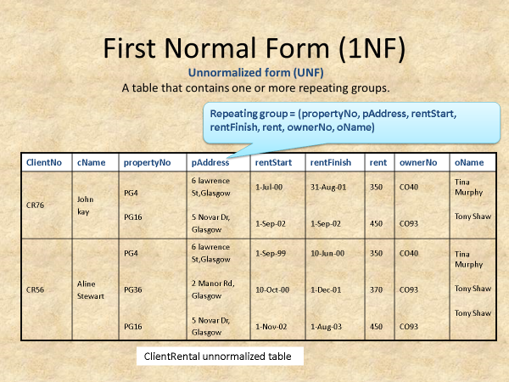
Normalize the below using the Functional dependency techniques

